Slide 1
Food Item Detection in Images
Pooja Ghatge
Department of Informatics and Networked Systems
Brandan Dunham
Department of Biomedical Informatics
Final Project Presentation: Scalable Machine Learning for Big Data Biology

Slide 2
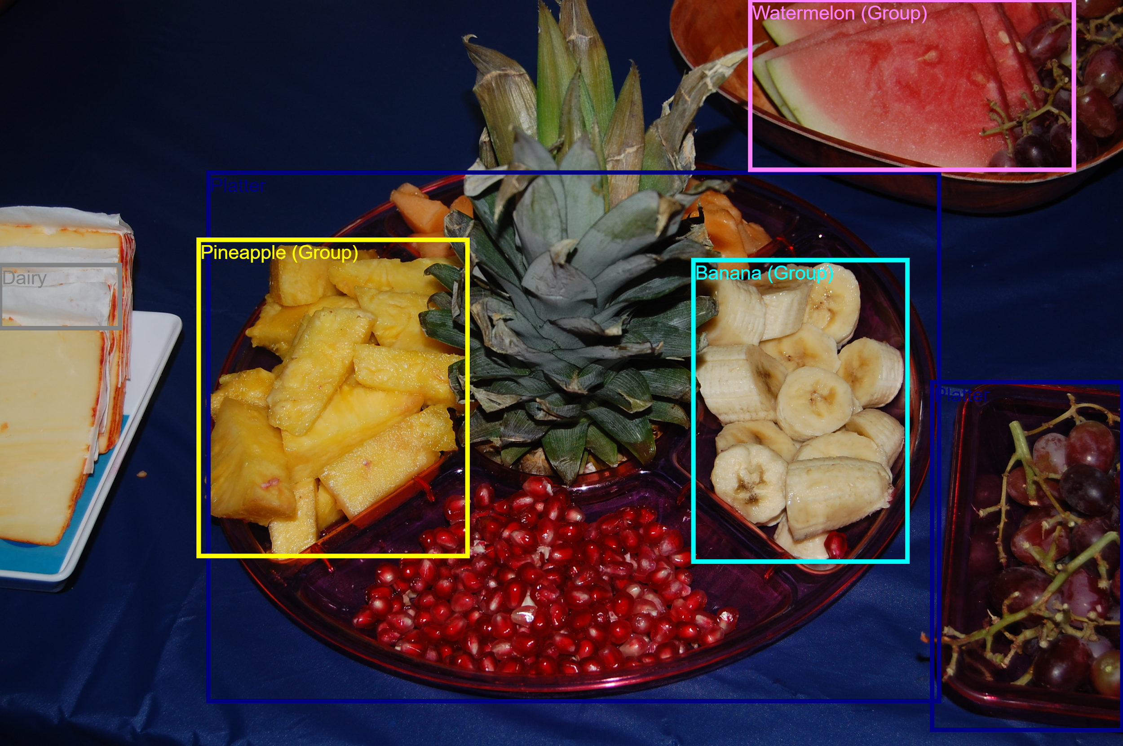
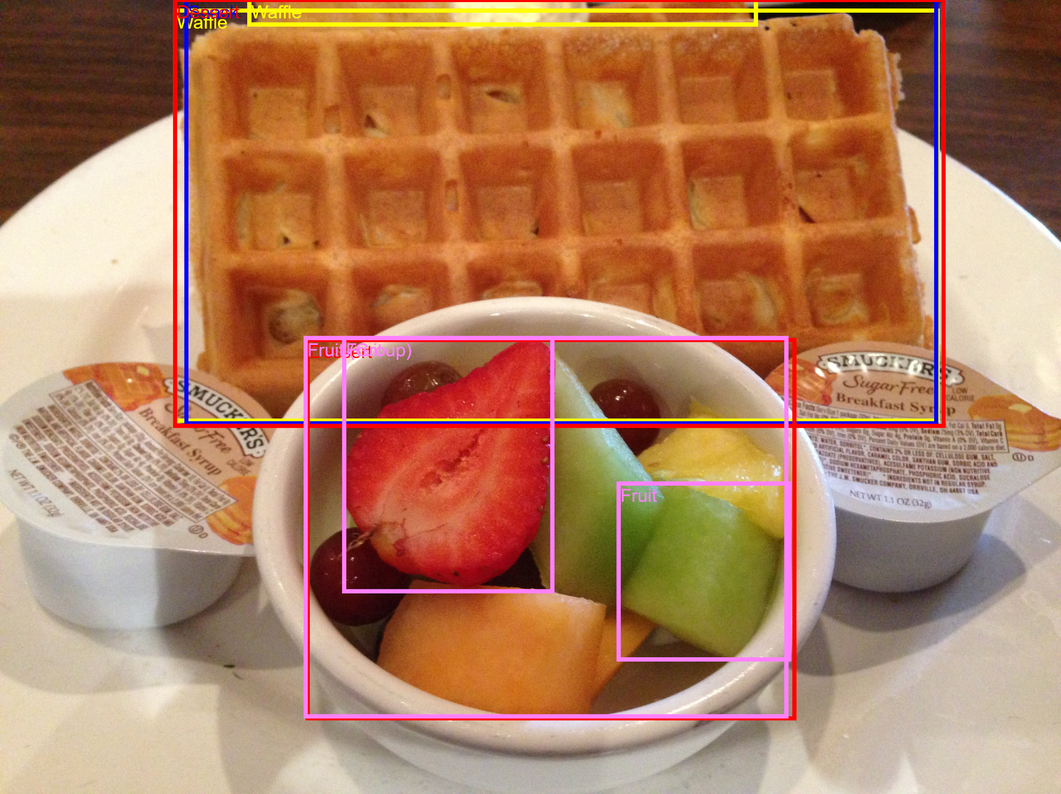
Problem Definition:
Identifying food objects in images by using object detection algorithms. This will be eventually useful in nutrition monitoring. The purpose is to implement active learning to improve the accuracy and efficiency of the selected model.

Slide 3
Technical Workflow:
Select an object detection API to detect food in food images
Adapt to food by training with labeled food images.
Implement active learning to minimize labels needed
Compare the learning rate of active learning with using the full dataset
Notes:
1st paper mentions weighting, max aggregation, entropy, catastrophic forgetting.
Related work used entropy to calculate confidence
The classification work moved high confidence images to training data
Some of the work did active learning to adjust box positions

Slide 4
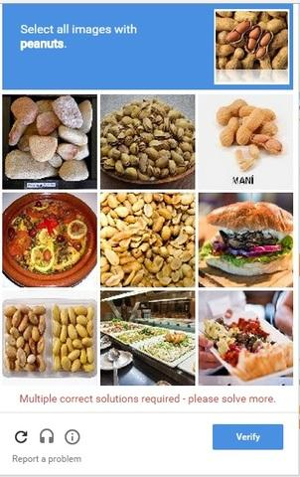
Problems With Object Detection
Getting images is easy, annotating them is hard
Not enough training images exist
Computer cannot automate the annotating process with high accuracy
People must manually annotate images
Costs time
Costs money
Has a moderate False Negative Rate
Costs more time and money to fix
Notes:
Manually annotating is slow and costly. We would like to minimize that step.
Also, we like minimizing steps involving people.

Slide 5
Active Learning to the Rescue
AI Classifier
Output
Confident
Not Confident
Human Annotation
Active Learning
Notes:
AI trains on small number of labeled images
Tests on unlabeled images
Selects set of images that it finds confusing.
Requests labels for the set
Add newly labeled items to training data
Repeats process.

Slide 6
Related Work:
Active Learning for Deep Object Detection Clemens-Alexander Brust, Christoph Kading, and Joachim Denzler
Localization-Aware Active Learning for Object Detection Chieh-Chi, Teng-Yok Lee, Mitsubishi Electric Research Laboratories, Pradeep Sen, and Ming-Yu Liu
Cost-Effective Active Learning for Deep Image Classification Keze Wang, Dongyu Zhang, Ya Li, Ruimao Zhang, and Liang Lin
Notes:
1st paper mentions weighting, max aggregation, entropy, catastrophic forgetting.
Related work used entropy to calculate confidence
The classification work moved high confidence images to training data
Some of the work did active learning to adjust box positions

Slide 7
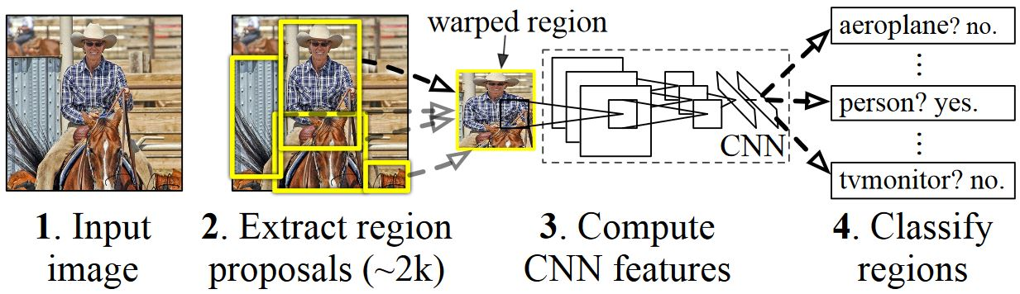
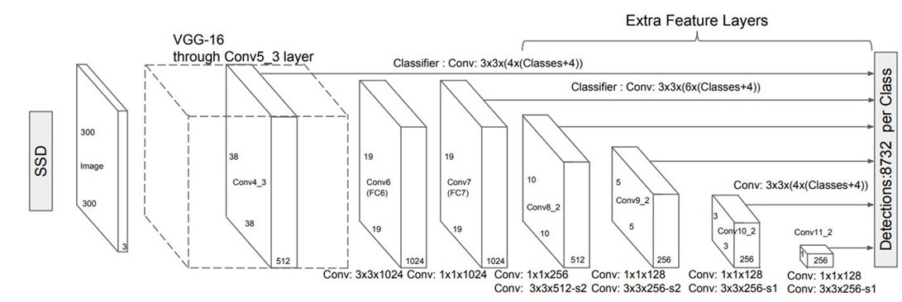
Tensorflow Built in Image Segmentation
Regions with CNN features (R-CNN)
Single-Shot Multibox Detector (SSD)
Notes:
RCNN scans image with different size boxes (learned from training?)
Makes a fixed number of proposals (in above example, 2k). Our selected RCNN uses a maximum 100 proposals.
All images are passed to neural network.
RCNN – Pass the image into the CNN for each region (really slow)
Fast RCNN – Pass the image into the CNN once, use the features from the pass using ROI pooling, select regions from there (faster)
Faster RCNN – Do the same as Fast RCNN, but reusing already calculated data and a faster region finding algorithm (fastest)
SSD – Single Shot Detector
Made for speed, 1 pass through the image.
Image goes through different layers to detect different size objects.
Traditionally struggles with smaller objects when using single layer, performing worse than RCNN but with much faster performance.
Increasing the number of layers improved performance to beat RCNN in some competitions.
Performed really slow on Albus when using batch size of 24 on resnet-50, uncertain why . . .
Both SSD and RCNN predict large number of boxes, and then only test the top X of them. For our experiment, we used faster designs which meant a lower number of predicted boxes were tested.

Slide 8
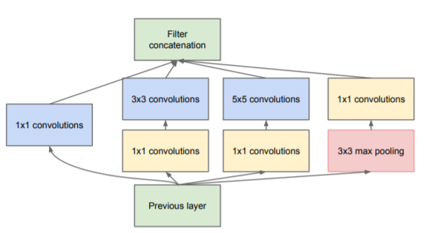
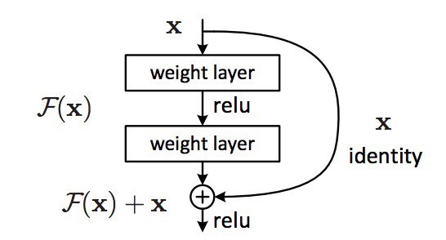
Tensorflow Built-in Image Classification
Resnet
Inception V2
Notes:
Inception – Go wider rather than deeper. Do things in parallel instead of multiple layers.
Relies on usage of 1x1 convolutions to reduce computational burden
V2 is batch normalized, computing mean and standard deviations of each feature map and normalizing it at each output layer.
V2 also recommends relying on multiple 3x3s rather than using 5x5 or 7x7.
Resnet is a residual neural network architecture.
Memory in layer.
Can overcome some problems of deeper architectures performing worse than networks with less layers.
50 is the number of layers in the model of Resnet we tried
Based on Resnet and Inception (v4)
Mobilenet is a variation of Xception that is made to contain less parameters with a smaller footprint.
Smaller size makes it good for running on mobile devices, although in some cases it has been shown to run slow.

Slide 9
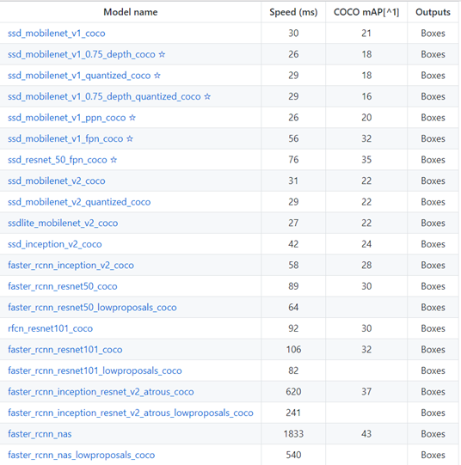
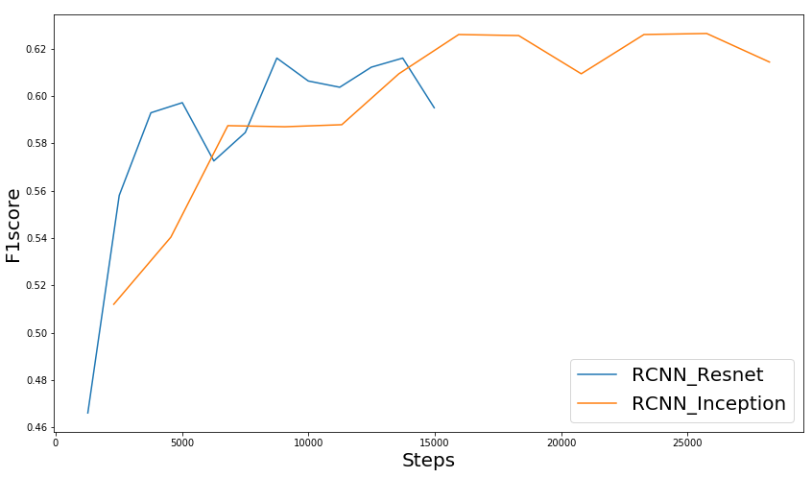
Pre-trained Models Offered by Object Detection API
Used faster models due to time limit.
Tested 4 models on smaller a 10 class dataset:
ssd_resnet_50_fpn_coco
ssd_mobilenet_v1_coco
faster_rcnn_resnet50_coco
faster_rcnn_inception_v2_coco
RCNN inception performed best
Notes:
COCO – Common Objects in Context, competition hosted by Microsoft for object detection (and related concepts, such as object relationships and object concepts)
10 Food items – Cake, donut, pizza, hot dog, carrot, broccoli, orange, sandwich, apple, banana
Drink Related items – Cup, Wine Glass, Bottle
mobilenet(21), ssd_res_fpn(35), inception(28), rcnn_res(30)
We looked into larger models as well.
Faster_rcnn_inception_resnet_v2_atrous_coco had an expected mAP of 37%, but would have taken 10 times longer to run.

Slide 10
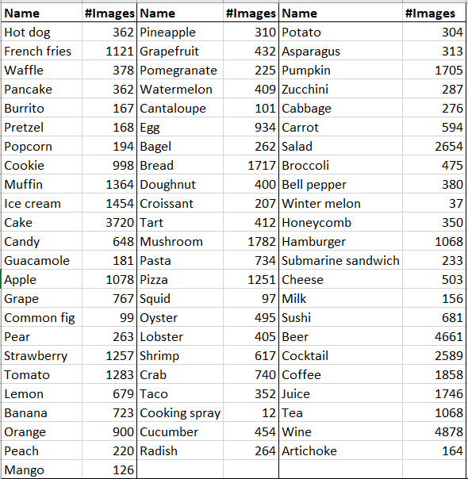
Data
Data source: Open Images Dataset V4
Data Size:
Number of images: 50,632 (train)
Annotated object in images: 142,2454 (train)
1) 86 GB (training images)
2) 12 GB (test images)
3) 4 GB (validation images)
Number of classes: 70

Slide 11
Preprocessing
50632 Images, 142254 annotations
40762 Images, 70648 annotations
39439 Images, 68470 annotations
Filter small boxes
Filter Images that couldn’t load
Filter depictions
Notes:
Small boxes: boxes which acquire less than 5% of the area.
Depictions: Boxes which are photos or drawings of the food.
Images that couldn’t load were not filtered out in preprocessing, but were filtered out when selected and tried to load into the algorithm.

Slide 12
Algorithm Used: faster_rcnn_inception_v2_coco model
The model was trained using following 3 train datasets:
 | Full Dataset | Balanced Dataset | Active Dataset
Images | All images in train data were used. | 200 per class, or all of the images if the class has less than 200 annotations. | The train data is divided into 5 sets. The first set : 75 images per class or 75% images of a class whichever is the smaller. The next four sets: Randomly sample remaining images into 4 sets without replacement.

Slide 13
Simulating Active Learning
Load current train set and model
3 hours training
(1st set of the 5 train sets)
Choose low confidence boxes generated from the previous step
Test model on the next held out train set
Oracle (labels the data)
Notes:
Predictions below a certain confidence level (starting at .05 originally, and increasing by .015 at each iteration) are removed.
The lowest confidence prediction is chosen. All other predictions from that image are removed from the sort. All instances of predictions for that class are increased by 4%
The above step is repeated 1200 times
For weighted version, 30% of the data is new, 70% of data is from previous iteration
We are assuming that we don’t know the labels of the next train set.
We are training the model on the current set and testing on the next train set.
We are predicting the labels of the next train set with a particular confidence values.
We are feeding the model the most useful images having lesser confidence values.
The whole idea is to generate comparable results using lesser amount of train data.

Slide 14
Resources:
CRC: h2p.crc.pitt.edu
GPU: GTX 1080 TI
Time: Each model was trained for 48 hours on CRC using 1 GPU.
Disk space: 300GB
Max RAM: 64GB

Slide 15
Metrics for accuracy calculation: mAP and F1
We have two ways of calculating accuracy:
Average : Calculates mAP/F1 of individual classes and average them.
Full : Calculates mAP/F1 of entire dataset.
Criteria to decide if a prediction is a true positive:
(Area(Predicted)∩Area(actual))
(Area(Predicted)∪Area(actual))
label(predicted)=label(actual)
Confidence of prediction > 50%
0.5
Notes:
Mean average precision:
We don’t have true negatives.
Anything which is predicted and doesn’t overlap with actual boxes is false positive
If there is an actual bounding box and its not predicted then its a False negative
Google data contains group of images (such as a group of grapes). When those images were scored, scoring uses area of intersection / area of predicted.

Slide 16
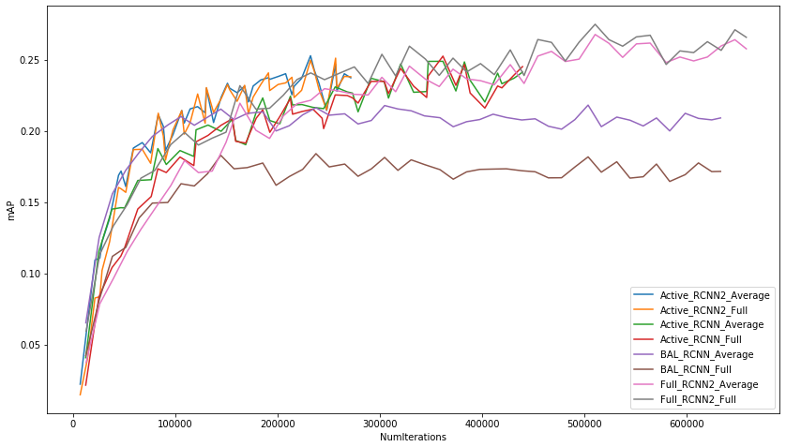
Average accuracy and Full accuracy gave almost the same results on the trained models:
Notes:
The model were trained in 4 ways.Using Full, Balanced, In Active_RCNN2 we add more number of images from the next train set such than they are atleast 30% of the old data.
These are the plots using 2 types of accuracy on the 4 models.
The average accuracy performed better than the full accuracy on the balanced train set.
Except for the balanced trains set, Average accuracy and Full accuracy gave almost the same results on the trained models
Active RCNN did less iterations due to using time to test and select images.
Active RCNN2 was slower due in part to making larger train sets (duplicating images), but mostly due to a slower graphics card (60% of the speed of other tests).

Slide 17
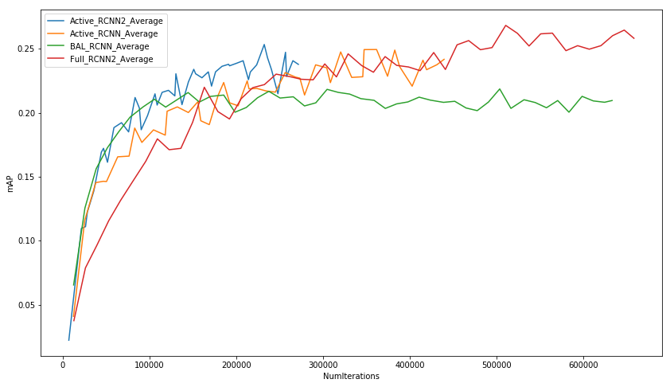
No. of iterations v/s mAP for each model.
Notes:
Green line is the model that we trained using balanced dataset.
Red line is the model that we trained using full dataset.
Blue line is the model that we trained using weighted active learning which achieved considerable accuracy in fewer iterations.
Active learning achieves higher accuracy in lesser number of iterations.

Slide 18
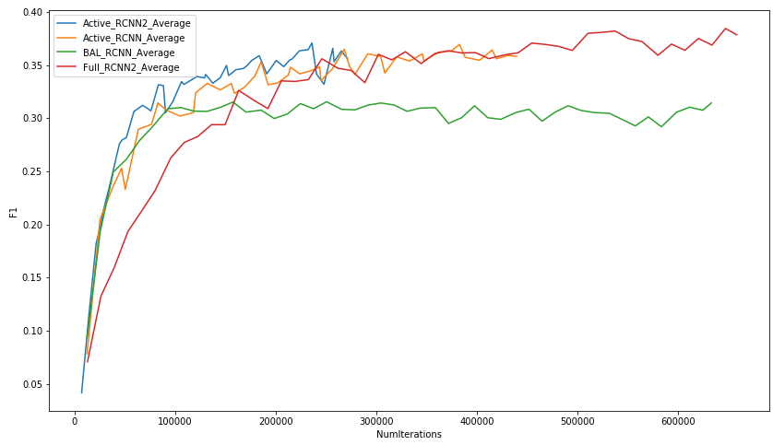
No. of iterations v/s F1 for each model.

Slide 19
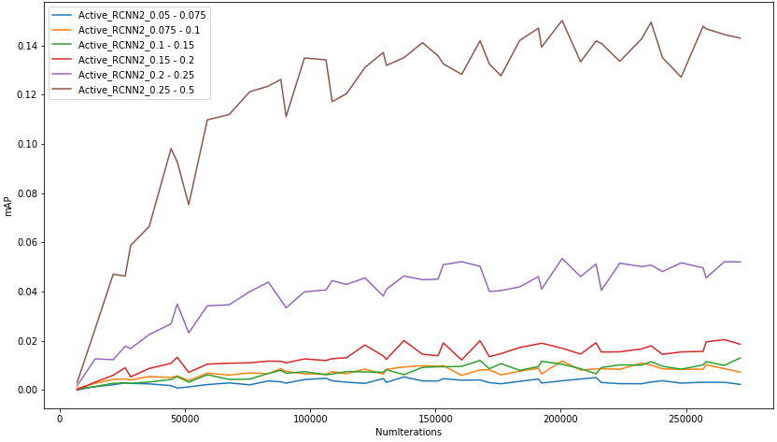
Accuracy for different size of the boxes :
Notes:
The accuracy of the size of the boxes which were less than 20% of the size of the actual image were considerably less.

Slide 20
Active Learning performs as well as using the full dataset with less images
User need not annotate the whole dataset.
While using 16,586 images (40% of the total train images) it gave accuracy which was as good as the entire dataset (36,000 images).
Performs as well or better than using a balanced dataset of the same number of images
Notes:
The user can annotate data that we are least confidence about.
Balanced used 13331 annotations. Looking at steps 13-20 for active learning (where is used slightly less or more images), it tests about the same as the balanced dataset. Technically, one of the active learning scores was mAP = .223, while balanced never reached above .218, but it was close. This was still early in the process, when most classes in active learning were balanced, so the results of active learning vs balanced are inconclusive. We need to try using more images in the balanced format in the future.

Slide 21
Future Work
More Active Learning Features:
Select images based on box size, combinations of images in files.
Get probability estimates for each class for each box
Use entropy calculation to select images.
Keep smaller food items in dataset
Run model without precomputed weights (non-transfer learning)
Notes:
Use larger balanced datasets

Slide 22
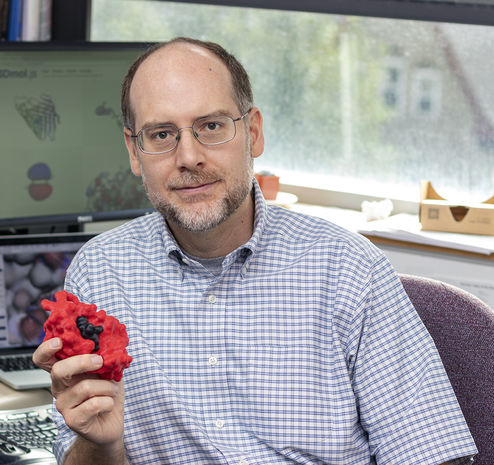




Acknowledgements
Prof. David Koes
Prof. Chakra Chennubhotla
Laavanya Rachakonda
Saraju P. Mohanty
Madhavi Ganapathiraju

Slide 23
References:
Image sources:
https://i.stack.imgur.com/5Sudf.jpg
https://scorecardstreet.wordpress.com/category/tensorflow/8 https://docs.microsoft.com/en-us/cognitive-toolkit/object-detection-using-fast-r-cnn
https://medium.com/@jonathan_hui/ssd-object-detection-single-shot-multibox-detector-for-real-time-processing-9bd8deac0e06
https://towardsdatascience.com/neural-network-architectures-156e5bad51ba https://towardsdatascience.com/an-intuitive-guide-to-deep-network-architectures-65fdc477db41
Stress-Log: An IoT-based Smart System to Monitor Stress-Eating
Laavanya Rachakonda; Arham Kothari; Saraju P. Mohanty; Elias Kougianos; Madhavi Ganapathiraju

Slide 24
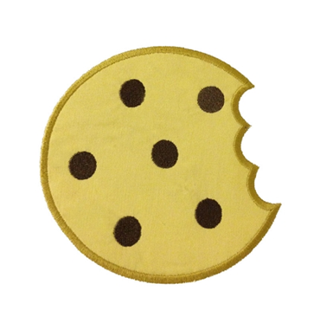
Questions

